Slide 1
Mathematical Models for Artificial Intelligence

Slide 2
A Typical AI System Pipeline
Data
Model
Output
Data
Feature Engineering & Selection
Dimensionality Reduction
Machine Learning Model
Decision/Action/Intelligence

Slide 3
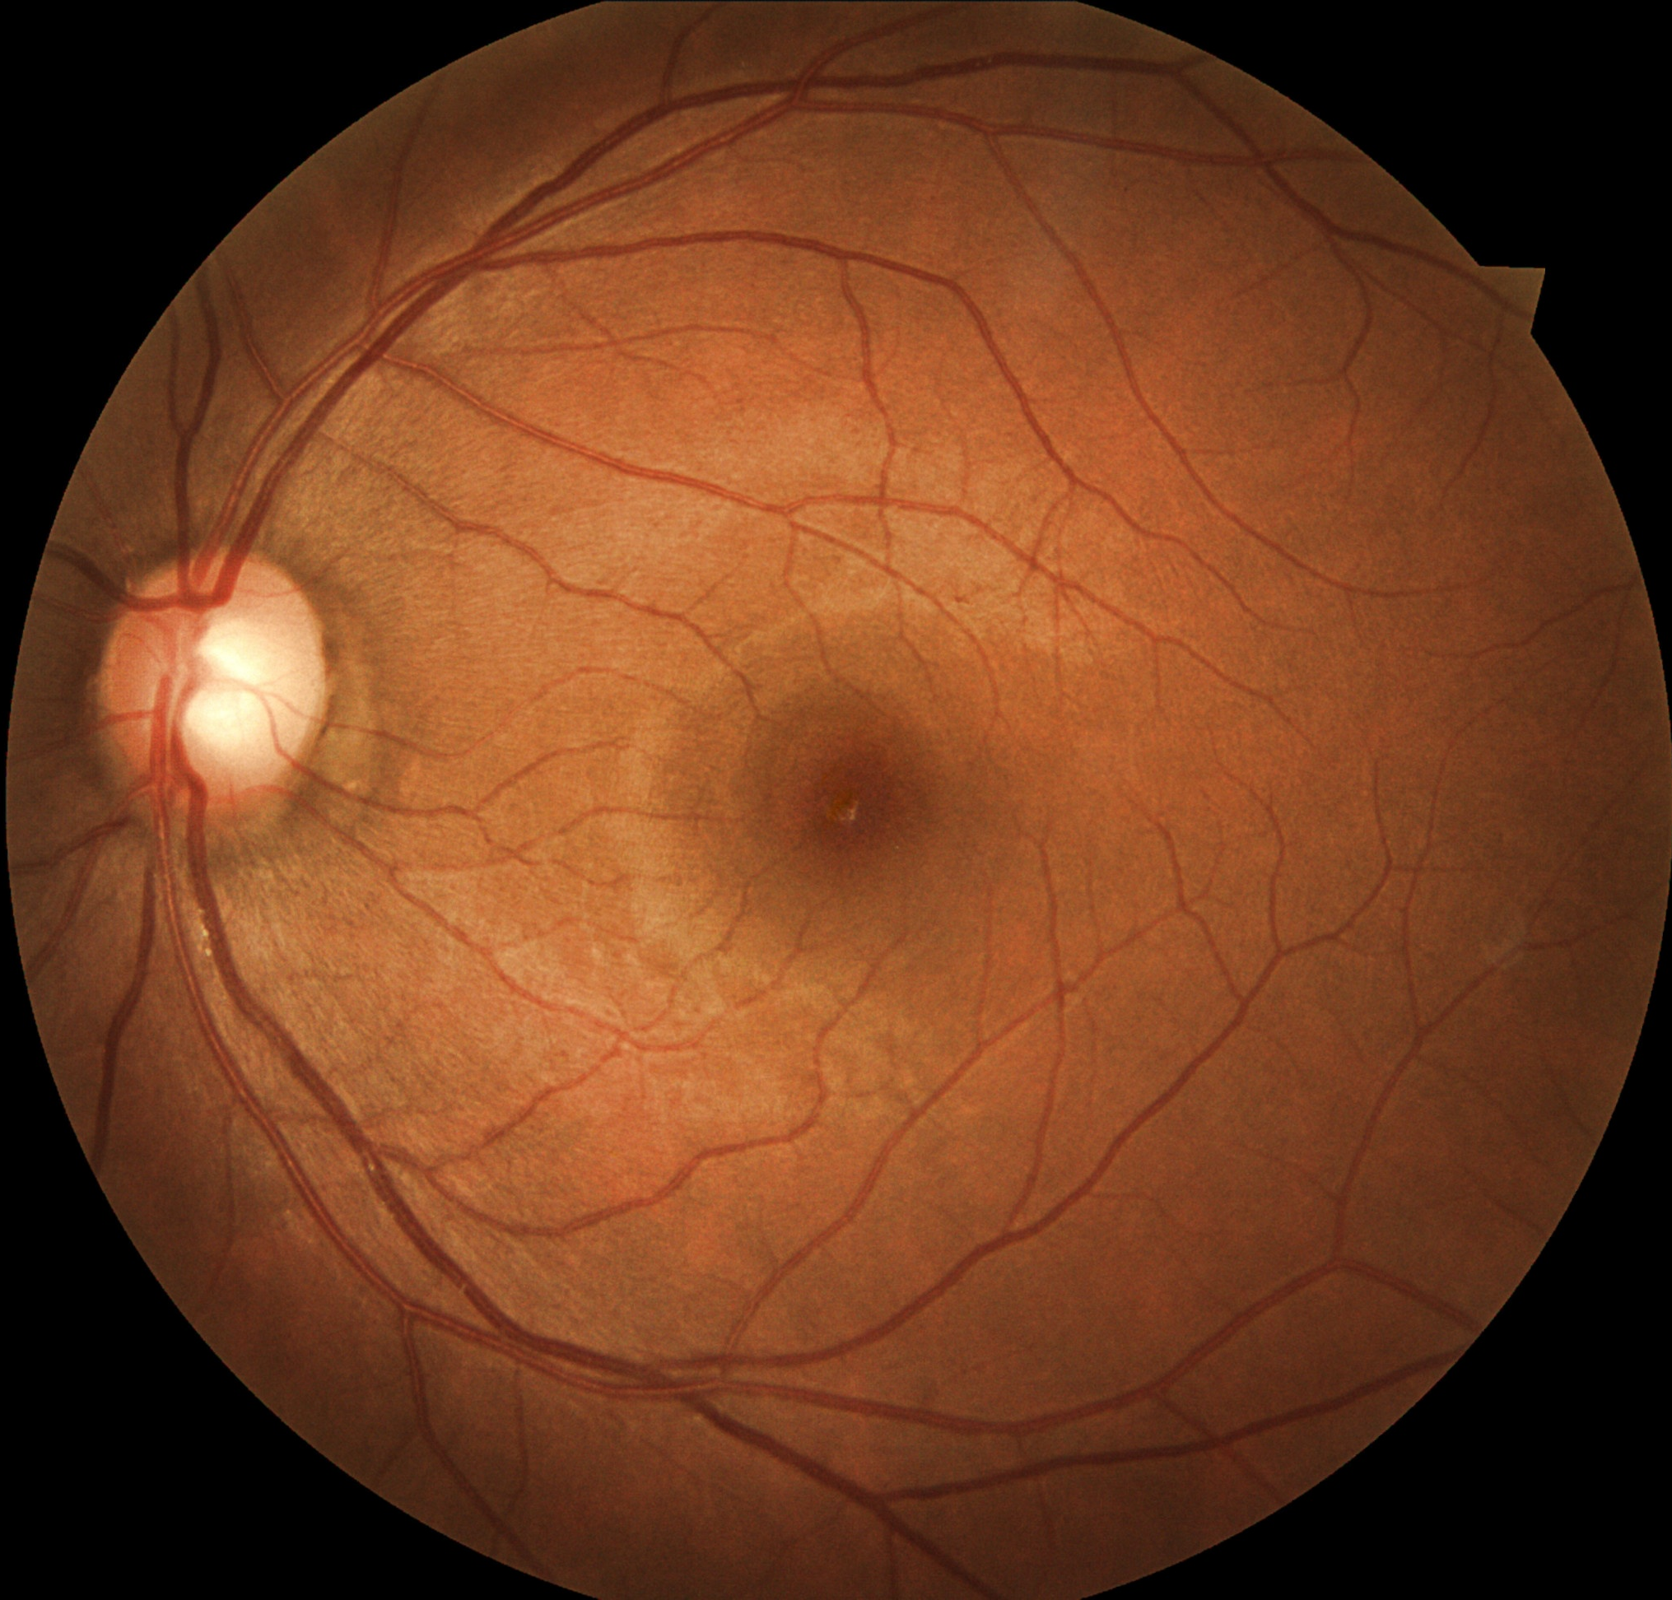
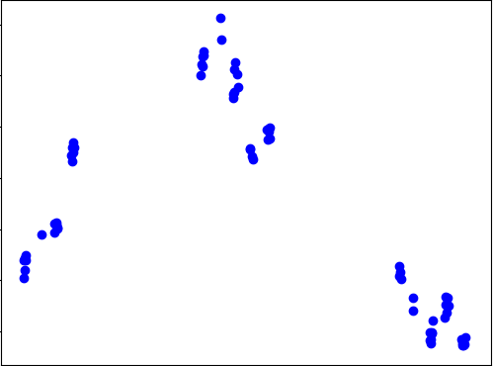
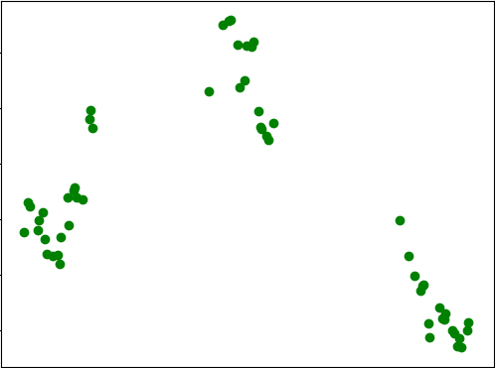
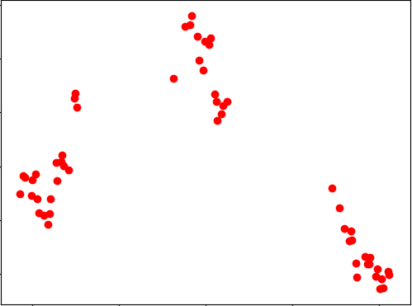
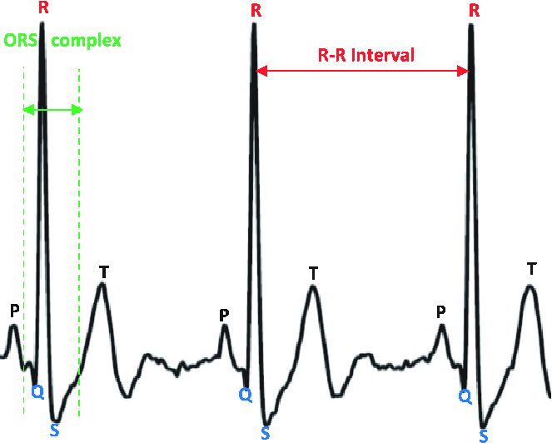
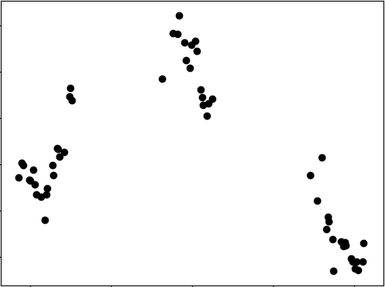
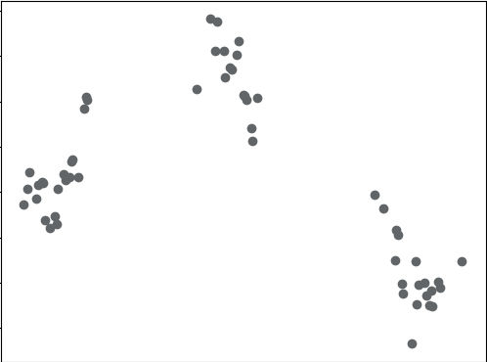
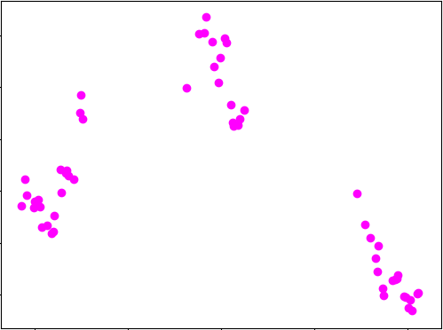
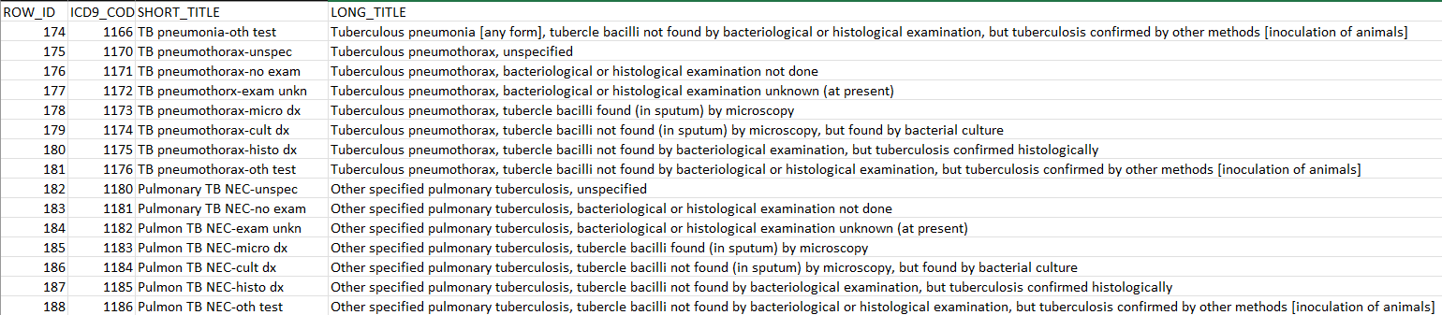
Data: Many Shapes and Forms

Slide 4
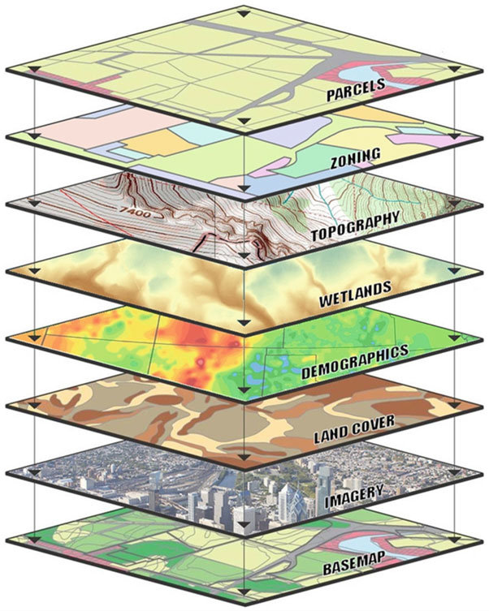
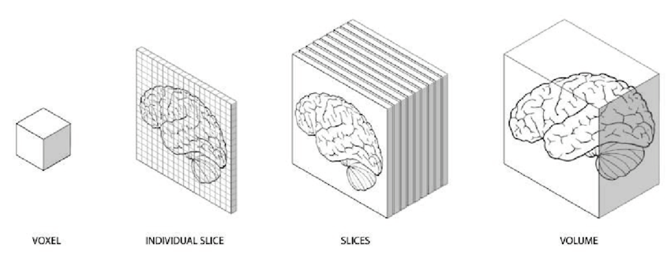
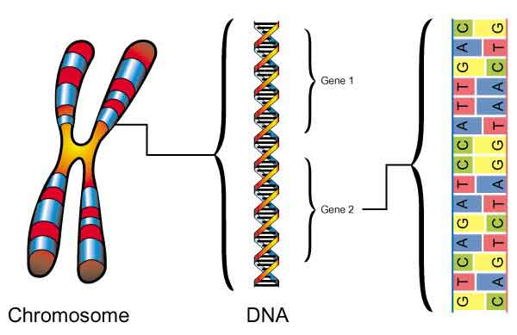
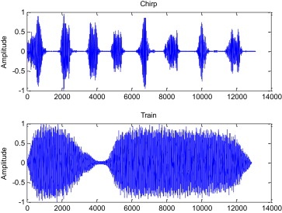

Data: Many Shapes and Forms

Slide 5
Data: Many Shapes and Forms
Data can be broadly divided into the following categories (that we will be dealing with in this course):
Structured/Tabular Data
Time Series Data
Images
Textual Data
Sometimes it may be advisable to use the raw data as is. However, other times, that is not the case.
“Reducing” the data to a compressed representation can be beneficial.

Slide 6
Dimensionality Reduction: The Need
As discussed earlier, modern data domains involve huge number of features/dimensions.
Documents: Thousands of words, millions of bigrams
Genomics: Thousands of genes, millions of DNA polymorphisms
Videos: Thousands of frames, millions of pixels per frame
From a theoretical point of view, this excess of features should be beneficial because increasing the number of features should lead to better performance (assuming independent features).

Slide 7
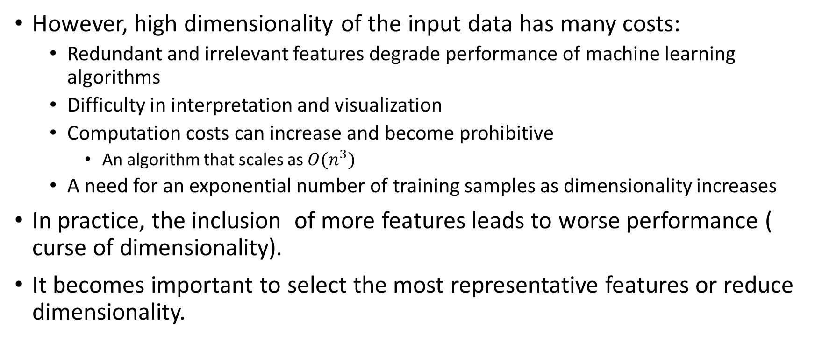
Dimensionality Reduction: The Need
However, high dimensionality of the input data has many costs:
Redundant and irrelevant features degrade performance of machine learning algorithms
Difficulty in interpretation and visualization
Computation costs can increase and become prohibitive
An algorithm that scales as ${O(n}^{3})$
A need for an exponential number of training samples as dimensionality increases
In practice, the inclusion of more features leads to worse performance ( curse of dimensionality).
It becomes important to select the most representative features or reduce dimensionality.

Slide 8
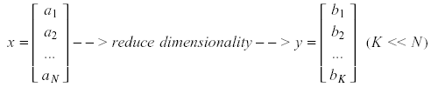
Dimensionality Reduction: The Need
Significant improvements can be achieved by first mapping the data into a lower-dimensional sub-space.
Dimensionality can be reduced by:
Combining features (linearly or non-linearly)
Linear combinations are particularly attractive because they are simple to compute and analytically tractable.

Slide 9
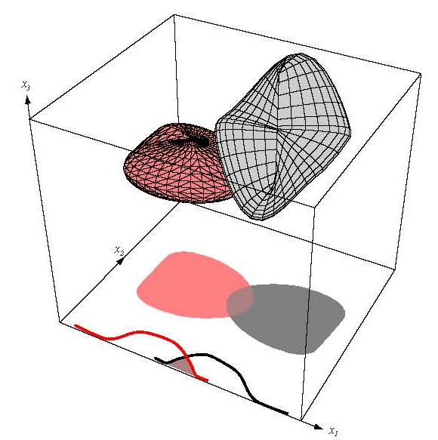
Dimensionality Reduction Techniques
Two classical approaches for finding optimal linear transformations are:
Principal Components Analysis (PCA): Seeks a projection that preserves as much information in the data as possible (in a least-squares sense).
Linear Discriminant Analysis (LDA): Seeks a projection that best separates the data (in a least-squares sense).

Slide 10
Principal Component Analysis (PCA)
Principal Component Analysis (PCA) is a linear transformation that chooses a new coordinate system such that:
Greatest variance by any projection of the dataset comes to lie on the first axis (usually called the first principal component)
The second variance on the second axis of the new coordinate system (second principal component)
PCA can be used for reducing dimensionality by eliminating some principal components (the later components).

Slide 11
Dimensionality Reduction as Data Compression: An Example
Reducing the dimensionality essentially compress the data (we can have the same information with fewer storage requirements).
Consider the following points:
If each number takes 1 byte, then we need 18 bytes to store all values.
1
2
3
2
4
6
4
8
12
3
6
9
5
10
15
6
12
18

Slide 12
Dimensionality Reduction as Data Compression: An Example
However, the points are related to one another geometrically
Each point is scaling of the first value by some factor.
2 4 3 5 6
Store one direction and the multiplying factors.
1
2
3
2
4
6
1
2
3
4
8
12
1
2
3
3
6
9
1
2
3
5
10
15
1
2
3
6
12
18

Slide 13
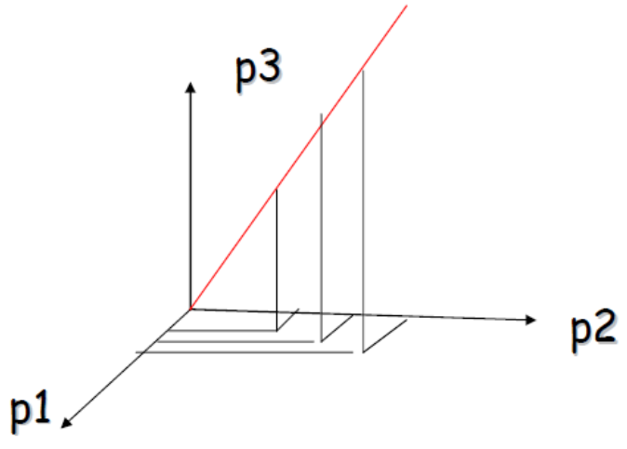
Geometrical Interpretation
As the point has 3 dimensions, it can be plotted in 3-dimensional space.
For this simple example, all the points lie on one line
That line can be viewed as a 1D subspace of the original 3D space

Slide 14
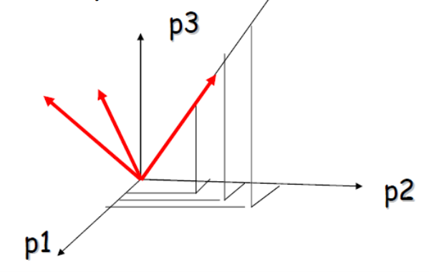
Geometrical Interpretation
Consider a new coordinate system where the first axis is the direction of the red line
In this new coordinate system, every point has only one non-zero coordinate
The direction of the line needs to be stored
And the non-zero coordinate for each point

Slide 15
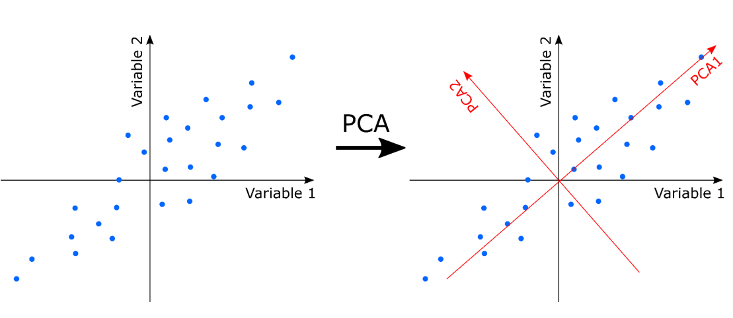
“Compression” Using PCA
Given a set of points in d dimensions, how can we know if they can be “compressed” as seen in the previous example?
We can use PCA to find out which directions to “compress” the data into.

Slide 16
What exactly is PCA doing?
In the previous example, PCA rebuilds the coordinate system of the input data by selecting:
The direction with the largest variance as the first new base direction
The direction with the second largest variance as the second new base direction
And so on…
The goal, then, becomes to find the direction with the largest variance.
This can be accomplished by calculating eigen vectors for the covariance matrix of the data.

Slide 17
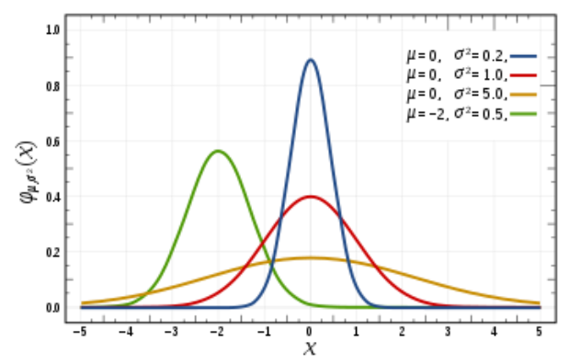
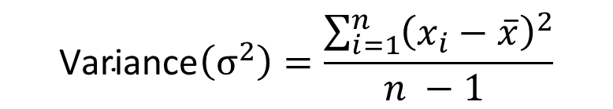
Aside: Review – Variance
Simply put, variance describes the spread of the data i.e., how far a set of random data point is spread out from their average.
$$\text{Variance}\left(σ^{2}\right)=\frac{\sum_{i=1}^{n}{{\left(x_{i}−\overline{x}\right)}^{2}}}{n −1 }$$

Slide 18
Aside: Covariance
Covariance is a measure of the joint variability of two random variables
If the greater values of one variable mainly correspond with the greater values of the other variable, and the same holds true for lesser values (similar behavior), the covariance is positive
In the opposite case, when the greater values of one variable mainly correspond to the lesser values of the other (opposite behavior), the covariance is negative.
The sign of the covariance shows the linear relationship between the variables.
The magnitude of the covariance is not normalized and depends on the magnitude of the variables (as opposed to correlation).

Slide 19
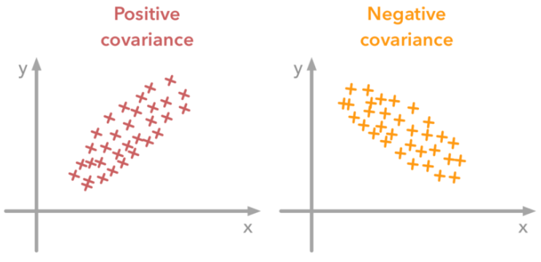
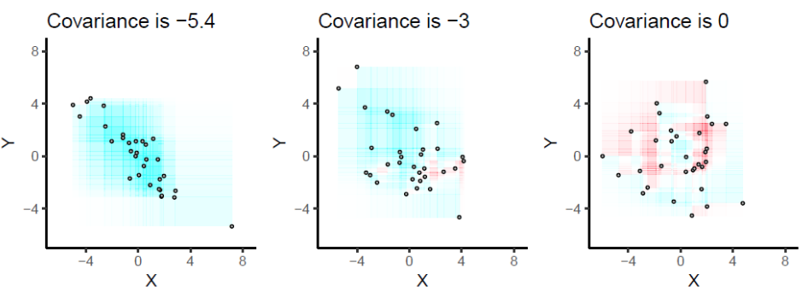
Aside: Covariance
Covariance is always between two dimensions (x,y).
For a dataset that has 3 dimensions (x,y,z) the covariance would be calculated between:
x and y
x and z
y and z

Slide 20
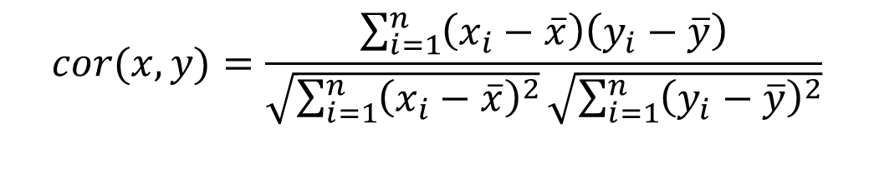
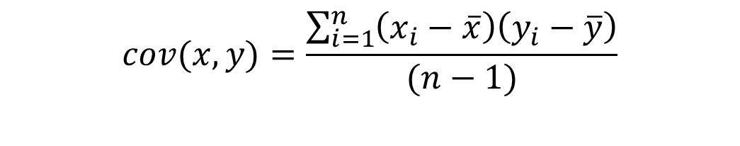

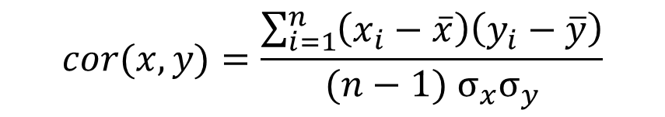
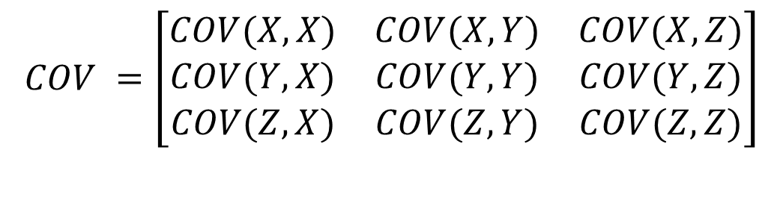
Aside: Covariance vs Correlation
$$cor(x,y)=\frac{\sum_{i=1}^{n}{\left(x_{i}−\overline{x}\right)\left(y_{i}−\overline{y}\right)}}{(n−1) σ_{x}σ_{y}}$$
$$cor(x,y)=\frac{\sum_{i=1}^{n}{\left(x_{i}−\overline{x}\right)\left(y_{i}−\overline{y}\right)}}{\sqrt{\sum_{i=1}^{n}{{\left(x_{i}−\overline{x}\right)}^{2}}}\sqrt{\sum_{i=1}^{n}{{\left(y_{i}−\overline{y}\right)}^{2}}}}$$
$$COV =\left[\begin{matrix}COV(X,X) & COV(X,Y) & COV(X,Z) \\ COV(Y,X) & COV(Y,Y) & COV(Y,Z) \\ COV(Z,X) & COV(Z,Y) & COV(Z,Z)\end{matrix}\right]$$
$$cov(x,y)=\frac{\sum_{i=1}^{n}{\left(x_{i}−\overline{x}\right)\left(y_{i}−\overline{y}\right)}}{(n−1)}$$
$$cov\left(x,y\right)=cov(y,x)$$

Slide 21
What exactly is PCA doing?
PCA tries to identify the subspace in which the data approximately lies in.
PCA uses an orthogonal transformation on the coordinate system to convert a set of observations of possibly correlated variables into a set of values of linearly uncorrelated variables.
The number of these new components is less than or equal to min{d, N} thus reducing the dimensions.

Slide 22
Steps for Applying PCA
Perform standardization on the data by centering the mean on 0.
Compute the covariance matrix of nxn dimensions.
Compute the Eigenvectors and Eigenvalues of the covariance matrix to identify the Principal Components.
Order the Eigenvectors based on their Eigenvalues and select the top K values.
Using these top K values, transform the original data to the new axis by matrix multiplication.

Slide 23
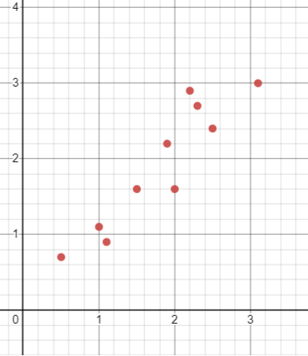
Step 1
X | Y
2.5 | 2.4
0.5 | 0.7
2.2 | 2.9
1.9 | 2.2
3.1 | 3.0
2.3 | 2.7
2 | 1.6
1 | 1.1
1.5 | 1.6
1.1 | 0.9
Mean: 1.81 | Mean: 1.91

Slide 24
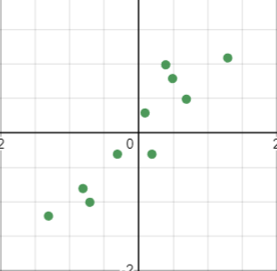
Step 1
X – Mean of X | Y – Mean of Y
0.69 | 0.49
-1.31 | -1.21
0.39 | 0.99
0.09 | 0.29
1.29 | 1.09
0.49 | 0.79
0.19 | -0.31
-0.81 | -0.81
-0.31 | -0.31
-0.71 | -1.01

Slide 25
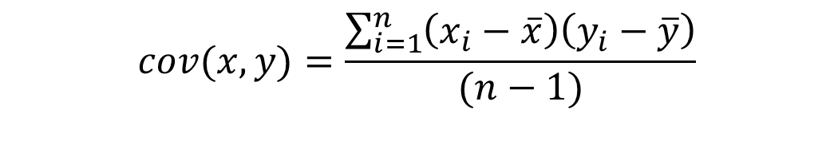

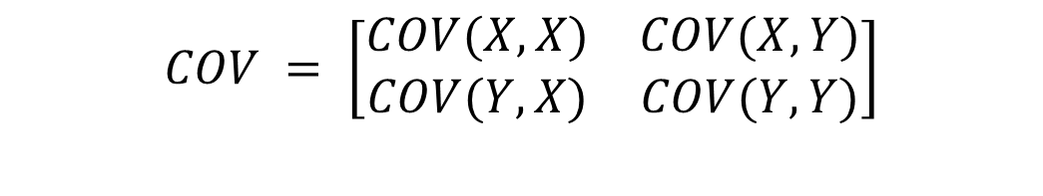
Step 2
$$cov(x,y)=\frac{\sum_{i=1}^{n}{\left(x_{i}−\overline{x}\right)\left(y_{i}−\overline{y}\right)}}{(n−1)}$$
$$COV = \left[\begin{matrix}COV(X,X) & COV(X,Y) \\ COV(Y,X) & COV(Y,Y)\end{matrix}\right]$$
X – Mean of X | Y – Mean of Y | (X – Mean of X)* (Y – Mean of Y) | (X – Mean of X)* (X – Mean of X) | (Y – Mean of Y)* (Y – Mean of Y)
0.69 | 0.49 | 0.3381 | 0.4761 | 0.2401
-1.31 | -1.21 | 1.5851 | 1.7161 | 1.4641
0.39 | 0.99 | 0.3861 | 0.1521 | 0.9801
0.09 | 0.29 | 0.0261 | 0.0081 | 0.0841
1.29 | 1.09 | 1.4061 | 1.6641 | 1.1881
0.49 | 0.79 | 0.3871 | 0.2401 | 0.6241
0.19 | -0.31 | -0.0589 | 0.0361 | 0.0961
-0.81 | -0.81 | 0.6561 | 0.6561 | 0.6561
-0.31 | -0.31 | 0.0961 | 0.0961 | 0.0961
-0.71 | -1.01 | 0.7171 | 0.5041 | 1.0201
Summation |  | 0.61544 | 0.616556 | 0.716556
$$COV = \left[\begin{matrix}0.6165 & 0.6154 \\ 0.6154 & 0.7165\end{matrix}\right]$$
Notes:
since the non-diagonal elements in this covariance matrix are positive, we should expect that both the x and y variable increase together.

Slide 26
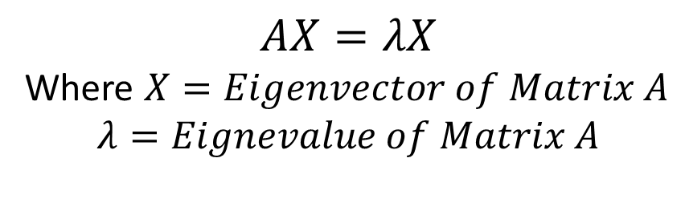



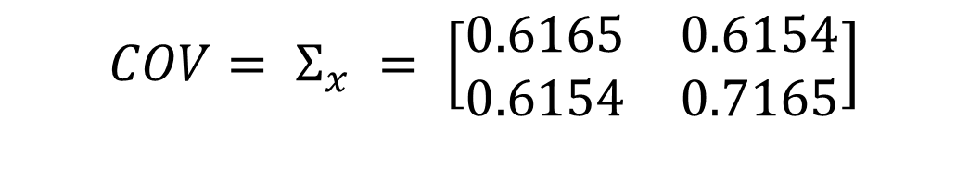
Step 3
$$COV= Σ_{x} = \left[\begin{matrix}0.6165 & 0.6154 \\ 0.6154 & 0.7165\end{matrix}\right]$$
$$Σ_{x} V=λV$$
$$AX=λX$$
Where $X=Eigenvector of Matrix A$
$$λ=Eignevalue of Matrix A$$
$$\left|Σ_{x} −λI\right|=0$$
The Eigenvalues are the zeros of the characteristic equation.
$$\frac{−b±\sqrt{b^{2}−4ac}}{2a}$$

Slide 27
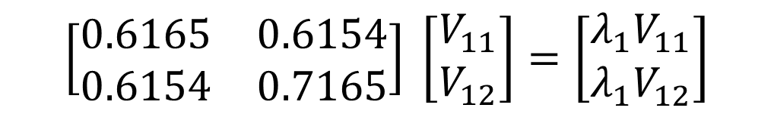

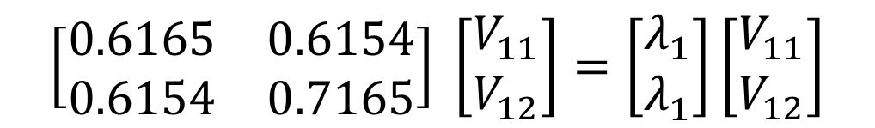
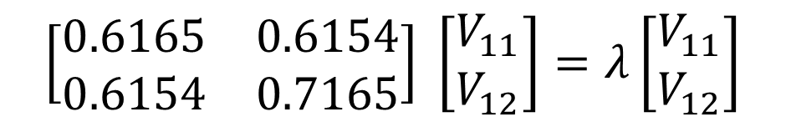
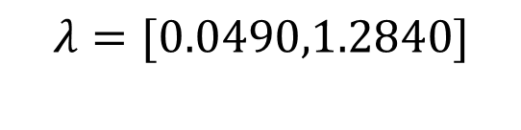
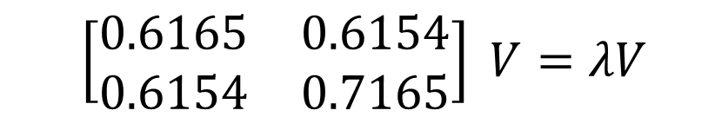
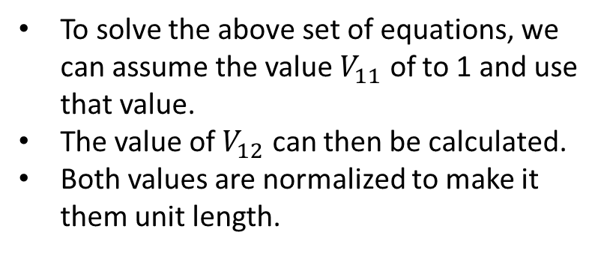

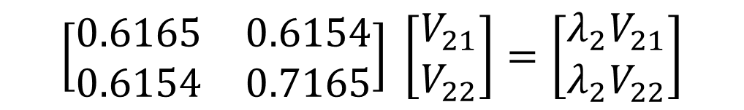
Step 3
$$λ=[λ_{1},λ_{2}]$$
$$\left[\begin{matrix}0.6165 & 0.6154 \\ 0.6154 & 0.7165\end{matrix}\right] \left[\begin{matrix}V_{11} \\ V_{12}\end{matrix}\right]=\left[\begin{matrix}λ_{1}V_{11} \\ {λ_{1}V}_{12}\end{matrix}\right]$$
$$λ=[0.0490,1.2840]$$
$$Σ_{x} V=λV$$
$$\left[\begin{matrix}0.6165 & 0.6154 \\ 0.6154 & 0.7165\end{matrix}\right] \left[\begin{matrix}V_{21} \\ V_{22}\end{matrix}\right]=\left[\begin{matrix}λ_{2}V_{21} \\ {λ_{2}V}_{22}\end{matrix}\right]$$
$$\left[\begin{matrix}0.6165 & 0.6154 \\ 0.6154 & 0.7165\end{matrix}\right] V=λV$$
To solve the above set of equations, we can assume the value $V_{11}$ of to 1 and use that value.
The value of $V_{12}$ can then be calculated.
Both values are normalized to make it them unit length.
$$\left[\begin{matrix}0.6165 & 0.6154 \\ 0.6154 & 0.7165\end{matrix}\right] \left[\begin{matrix}V_{11} \\ V_{12}\end{matrix}\right]=λ\left[\begin{matrix}V_{11} \\ V_{12}\end{matrix}\right]$$
$$\left[\begin{matrix}0.6165 & 0.6154 \\ 0.6154 & 0.7165\end{matrix}\right] \left[\begin{matrix}V_{11} \\ V_{12}\end{matrix}\right]=\left[\begin{matrix}λ_{1} \\ λ_{1}\end{matrix}\right]\left[\begin{matrix}V_{11} \\ V_{12}\end{matrix}\right]$$

Slide 28


Step 3
The sign of Eigenvector does not really matter
Vectors in opposite direction
They are to be sorted according to the Eigne Value.
The Eigenvectors are perpendicular to each other.
One of the Eigenvectors goes through the middle of the points, like drawing a line with the best fit.
$$\left[\begin{matrix}−0.7351 & −0.6778\end{matrix}\right]$$
$$\left[\begin{matrix}0.6778 & −0.7351\end{matrix}\right]$$

Slide 29
Step 4
Once the Eigenvectors have been sorted based on the Eigenvalues, the components with the lesser significance can be ignored.
Ignoring these components would result in losing some information, however, that information would be small.
We choose k eigenvectors where k is less than n
In our example, we can choose either both the Eigenvectors or just one.

Slide 30
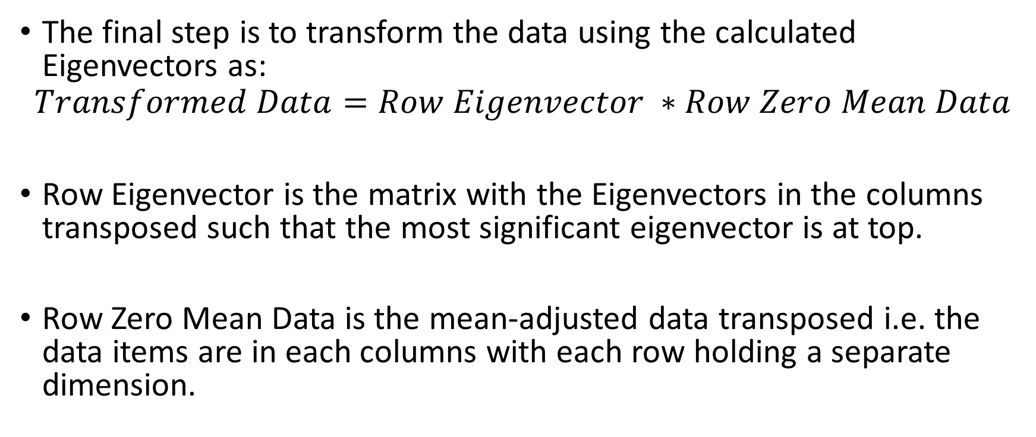
Step 5
The final step is to transform the data using the calculated Eigenvectors as:
$$Transformed Data=Row Eigenvector ∗Row Zero Mean Data$$
Row Eigenvector is the matrix with the Eigenvectors in the columns transposed such that the most significant eigenvector is at top.
Row Zero Mean Data is the mean-adjusted data transposed i.e. the data items are in each columns with each row holding a separate dimension.

Slide 31
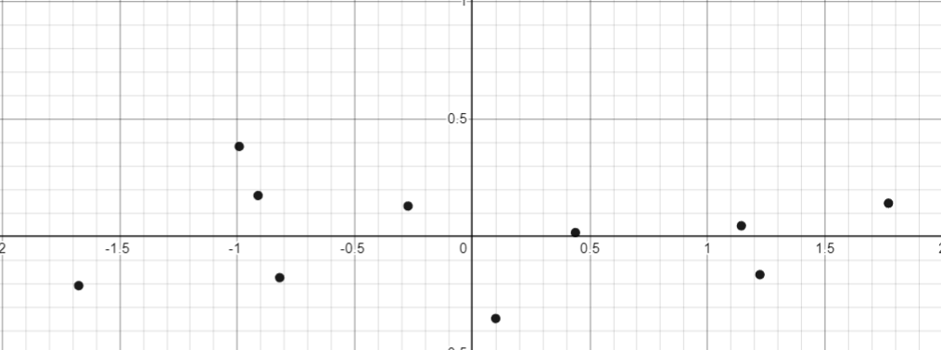
Step 5
X | Y
-0.82 | -0.175
1.77 | 0.142
-0.992 | 0.384
-0.274 | 0.130
-1.675 | -.209
-0.912 | 0.175
0.099 | -0.349
1.144 | 0.046
0.438 | 0.017
1.223 | -0.162

Slide 32
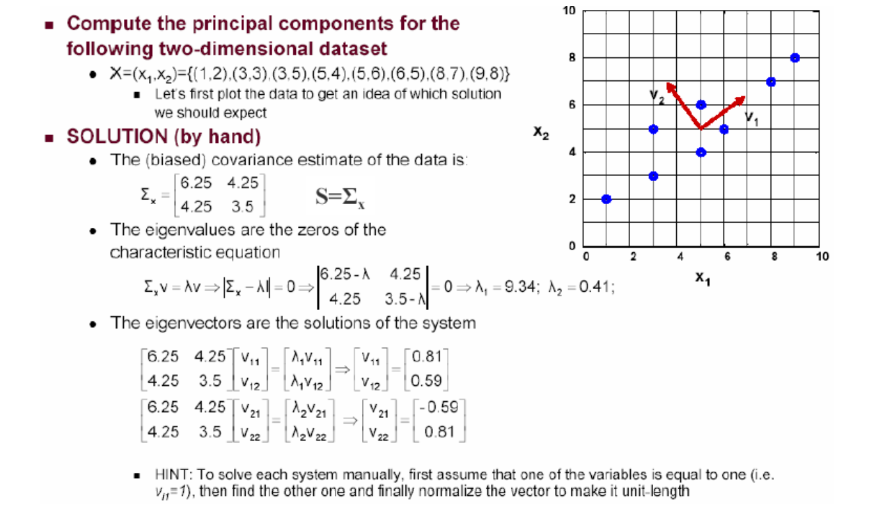
PCA – Another Solved Example

Slide 33
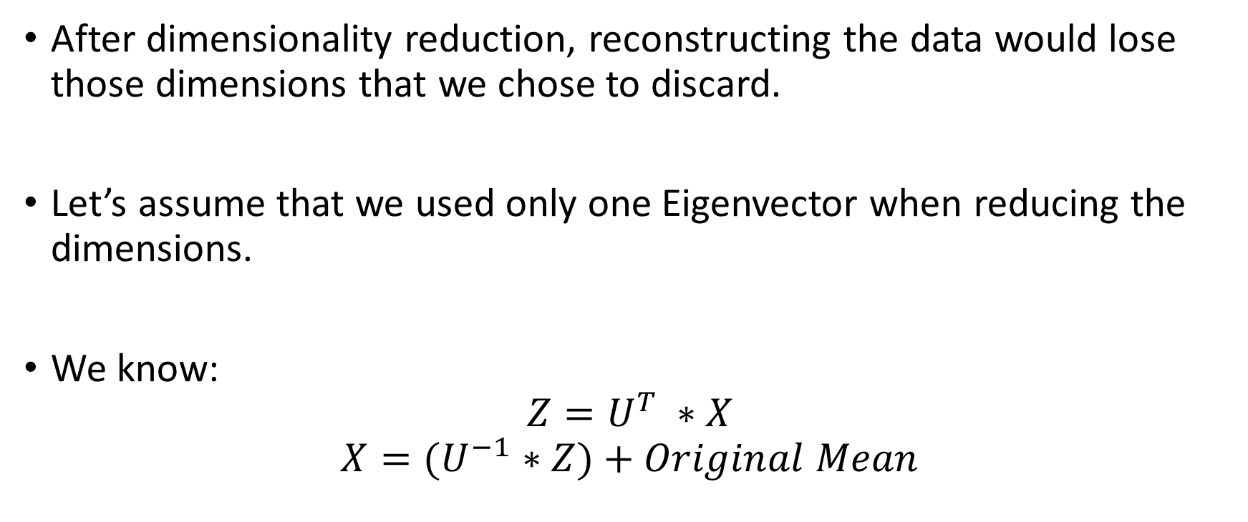
Reconstruction of the Original Data
After dimensionality reduction, reconstructing the data would lose those dimensions that we chose to discard.
Let’s assume that we used only one Eigenvector when reducing the dimensions.
We know:
$$Z=U^{T} ∗X$$
$$X={(U}^{−1} ∗Z)+Original Mean$$

Slide 34
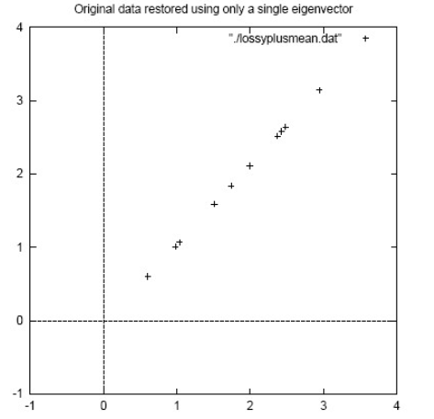
Reconstruction of the Original Data
X
-0.82
1.77
-0.992
-0.274
-1.675
-0.912
0.099
1.144
0.438
1.223

Slide 35
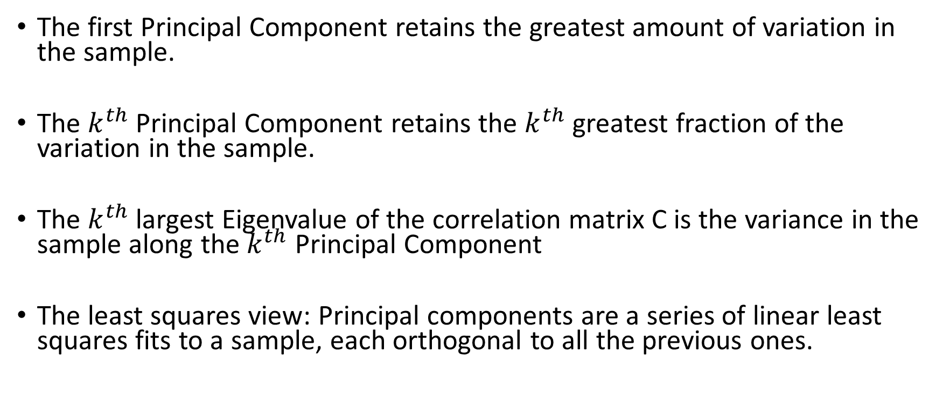
Selecting K Principal Components
The first Principal Component retains the greatest amount of variation in the sample.
The $k^{th}$ Principal Component retains the $k^{th}$ greatest fraction of the variation in the sample.
The $k^{th}$ largest Eigenvalue of the correlation matrix C is the variance in the sample along the $k^{th}$ Principal Component
The least squares view: Principal components are a series of linear least squares fits to a sample, each orthogonal to all the previous ones.

Slide 36
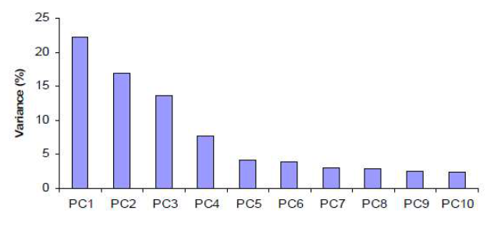
Selecting K Principal Components
Can ignore the components of lesser significance.

Slide 37
PCA Shortcomings
Notice that when using PCA we do not concern ourselves with the different classes in the data.
Each sample is used as is without the information of the classification label.
If the classes are separable in with the original features, using PCA will keep them separable.
However, the above may not hold true in every case.

Slide 38
Linear Discriminant Analysis (LDA)
Perform dimensionality reduction “while preserving as much of the class discriminatory information as possible”.
Seeks to find directions along which the classes are best separated.
Takes into consideration the scatter within-classes but also the scatter between-classes.

Slide 39
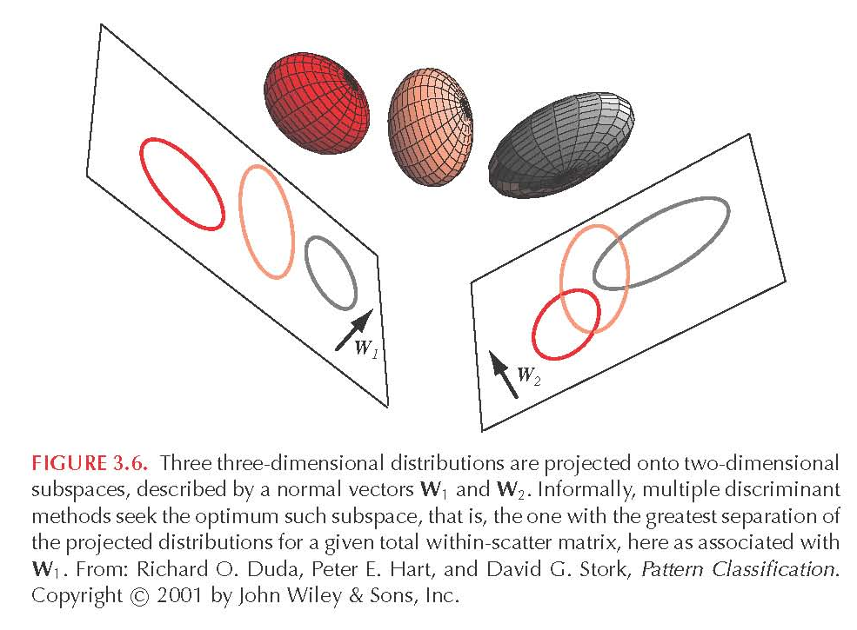
Linear Discriminant Analysis (LDA)

Slide 40
Fisher’s linear discriminant
A simple linear discriminant function is a projection of the data down to 1-D.
So choose the projection that gives the best separation of the classes. What do we mean by “best separation”?
An obvious direction to choose is the direction of the line joining the class means.
But if the main direction of variance in each class is not orthogonal to this line, this will not give good separation (see the next figure).
Fisher’s method chooses the direction that maximizes the ratio of between class variance to within class variance.
This is the direction in which the projected points contain the most information about class membership (under Gaussian assumptions)

Slide 41
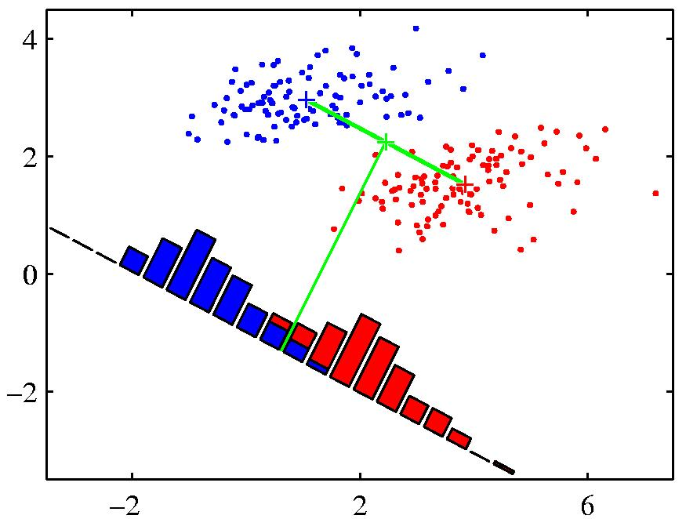

A picture showing the advantage of Fisher’s linear discriminant.
When projected onto the line joining the class means, the classes are not well separated.
Fisher chooses a direction that makes the projected classes much tighter, even though their projected means are less far apart.

Slide 42

PCA vs LDA

Slide 43
Steps for Applying LFDA
Compute the mean of both the classes in n dimensional space.
Calculate the scatter matrices for both the classes.
Calculate the matrices for within- and between-classes scatter.
Calculate Eigenvalues and Eigenvectors for product of within- and between classes scatter matrix (where inverse of the within class matrix is taken).
Using the Eigenvector, transform the original data to the new axis by matrix multiplication.

Slide 44

Step 1
X | Y | Label | Means
2.5 | 2.4 | 0 | [2.04, 2.24]
0.5 | 0.7 | 0
2.2 | 2.9 | 0
1.9 | 2.2 | 0
3.1 | 3.0 | 0
2.3 | 2.7 | 1 | [1.58, 1.58]
2 | 1.6 | 1
1 | 1.1 | 1
1.5 | 1.6 | 1
1.1 | 0.9 | 1

Slide 45



Step 2
$$cov(x,y)=\frac{\sum_{i=1}^{n}{\left(x_{i}−\overline{x}\right)\left(y_{i}−\overline{y}\right)}}{(n−1)}$$
X – Mean of X | Y – Mean of Y | (X – Mean of X)* (Y – Mean of Y) | (X – Mean of X)* (X – Mean of X) | (Y – Mean of Y)* (Y – Mean of Y)
0.46 | 0.16 | 0.0736 | 0.2116 | 0.0256
-1.54 | -1.54 | 2.3716 | 2.3716 | 2.3716
0.16 | 0.66 | 0.1056 | 0.0256 | 0.4356
-0.14 | -0.04 | 0.0056 | 0.0196 | 0.0016
1.06 | 0.76 | 0.8056 | 1.1236 | 0.5776
Summation |  | 3.362 | 3.752 | 3.412
0.72 | 1.12 | 0.8064 | 0.5184 | 1.2544
0.42 | 0.02 | 0.0084 | 0.1764 | 0.0004
-0.58 | -0.48 | 0.2784 | 0.3364 | 0.2304
-0.08 | 0.02 | -0.0016 | 0.0064 | 0.0004
-0.48 | -0.68 | 0.3264 | 0.2304 | 0.4624
Summation |  | 1.418 | 1.268 | 1.948
$$COV = \left[\begin{matrix}COV(X,X) & COV(X,Y) \\ COV(Y,X) & COV(Y,Y)\end{matrix}\right]$$
S1$= \left[\begin{matrix}0.938 & 0.840 \\ 0.840 & 0.853\end{matrix}\right]$
S2$= \left[\begin{matrix}0.317 & 0.354 \\ 0.354 & 0.487\end{matrix}\right]$
Notes:
since the non-diagonal elements in this covariance matrix are positive, we should expect that both the x and y variable increase together.

Slide 46











Step 3
$$S_{b}=Between Class Scatter$$
$$S_{w}=Within Class Scatter$$
$$S_{b}=Dot Product of Differences of Means$$
$$S_{w}=Sum of Scatter Matrices$$
$$m=\left[\begin{matrix}2.04 & 2.24\end{matrix}\right]$$
$$n=\left[\begin{matrix}1.58 & 1.58\end{matrix}\right]$$
$$S_{w}=\left[\begin{matrix}1.255 & 1.194 \\ 1.194 & 1.34\end{matrix}\right]$$
$$m−n=\left[\begin{matrix}0.46 & 0.66\end{matrix}\right]$$
$$\left[\begin{matrix}0.46 \\ 0.66\end{matrix}\right]$$
$$\left[\begin{matrix}0.46 & 0.66\end{matrix}\right]$$
$$S_{b}=\left[\begin{matrix}0.211 & 0.303 \\ 0.303 & 0.435\end{matrix}\right]$$

Slide 47










Step 4
$$\left[\begin{matrix}5.233 & −4.66 \\ −4.66 & 4.901\end{matrix}\right]\left[\begin{matrix}0.211 & 0.303 \\ 0.303 & 0.435\end{matrix}\right]V=λV$$
$$Σ_{x} V=λV$$
$$S_{w}^{−1}S_{b}V=λV$$
$$\left[\begin{matrix}−0.307 & −0.441 \\ 0.501 & 0.719\end{matrix}\right]V=λV$$
$$S_{w}=\left[\begin{matrix}1.255 & 1.194 \\ 1.194 & 1.34\end{matrix}\right]$$
$$AX=λX$$
Where $X=Eigenvector of Matrix A$
$$λ=Eignevalue of Matrix A$$
$$S_{w}^{−1}=\frac{1}{0.256}\left[\begin{matrix}1.34 & −1.194 \\ −1.194 & 1.255\end{matrix}\right]$$
$$\left|Σ_{x} −λI\right|=0$$
$$S_{w}^{−1}=\left[\begin{matrix}5.233 & −4.66 \\ −4.66 & 4.901\end{matrix}\right]$$
$$\frac{−b±\sqrt{b^{2}−4ac}}{2a}$$

Slide 48









Step 4
$$λ=[λ_{1},λ_{2}]$$
$$\left[\begin{matrix}−0.307 & −0.441 \\ 0.501 & 0.719\end{matrix}\right]\left[\begin{matrix}V_{1} \\ V_{2}\end{matrix}\right]=\left[\begin{matrix}λ_{ }V_{1} \\ {λ_{ }V}_{2}\end{matrix}\right]$$
$$λ=[0.718,−0.306]$$
$$λ=0.718$$
$$\left[\begin{matrix}−0.307 & −0.441 \\ 0.501 & 0.719\end{matrix}\right]\left[\begin{matrix}V_{1} \\ V_{2}\end{matrix}\right]=\left[\begin{matrix}{0.718}_{ }V_{1} \\ {−0.306V}_{2}\end{matrix}\right]$$
$$Σ_{x} V=λV$$
$$\left[\begin{matrix}−0.307 & −0.441 \\ 0.501 & 0.719\end{matrix}\right]V=λV$$
To solve the above set of equations, we can assume the value $V_{1}$ of to 1 and use that value.
Both values are normalized to make it them unit length.
$$\left[\begin{matrix}−0.307 & −0.441 \\ 0.501 & 0.719\end{matrix}\right]\left[\begin{matrix}V_{1} \\ V_{2}\end{matrix}\right]=λ\left[\begin{matrix}V_{1} \\ V_{2}\end{matrix}\right]$$

Slide 49






Step 4
$${eigenvector= S}_{w}^{−1}(m−n)$$
$$\left[\begin{matrix}0.409 & −0.955\end{matrix}\right]$$
$$S_{w}^{−1}=\left[\begin{matrix}5.233 & −4.66 \\ −4.66 & 4.901\end{matrix}\right]$$
$$m−n=\left[\begin{matrix}0.46 & 0.66\end{matrix}\right]$$
$$\left[\begin{matrix}−0.668 & 1.091\end{matrix}\right]$$
$$\left[\begin{matrix}−0.522 & 0.855\end{matrix}\right]$$

Slide 50


Step 5
$$\left[\begin{matrix}0.409 & −0.955\end{matrix}\right]$$
X | Y | Label | Transformed
2.5 | 2.4 | 0 | -1.2695
0.5 | 0.7 | 0 | -0.464
2.2 | 2.9 | 0 | -1.8697
1.9 | 2.2 | 0 | -1.3239
3.1 | 3.0 | 0 | -1.5971
2.3 | 2.7 | 1 | -1.6378
2 | 1.6 | 1 | -0.71
1 | 1.1 | 1 | -0.6415
1.5 | 1.6 | 1 | -0.9145
1.1 | 0.9 | 1 | -0.4096

Slide 51

LFDA –Solved Example

Slide 52
How Many Classes?
PCA does not consider the different classes in the data, so the number of classes can be infinite.
LDA works for 2 classes only.
So how can we apply LDA on more than 2 classes?
We group n-1 classes as a single class and the remaining class.
In this way, we again end up with two classes.

Slide 53

Pearson Correlation Coefficient is a measure of how two variables are related to one another and is calculated using the formula:
$$r_{X,Y}=\frac{\sum_{i=1}^{n}{\left(x_{i}−\overline{x}\right)\left(y_{i}−\overline{y}\right)}}{\sqrt{\sum_{i=1}^{n}{{\left(x_{i}−\overline{x}\right)}^{2}}}\sqrt{\sum_{i=1}^{n}{{\left(y_{i}−\overline{y}\right)}^{2}}}}$$
X_1 | 3 | 4 | 5 | 6 | 7
X_2 | 9 | 8 | 7 | 6 | 5
EVEN ROW
X_1 | 3 | 4 | 5 | 6 | 7
X_2 | 5 | 6 | 7 | 8 | 9
ODD ROW

Slide 54
A point in 3D space is given as: [1, 2, 3]
Use the following Eigen Vectors to transform it to 3 PCA dimensions.
EVEN ROW
ODD ROW
[-0.3, 0.3, 2.3]
[0.6, 0.3, 0.4]
[0.4, 0.7, 0.3]
[1.5, 2, 0.3]
[0.7, 0.2, 0.5]
[1, 0.5, 3.5]

Slide 55
Best of Luck!!!
Take the risk of thinking for yourself, much more happiness, truth, beauty and wisdom will come to you that way.
--Christopher Hitchens

